Slide 1
Distance Formula
What is the exact distance between (-4,3) and (6,-1)?
What is the approximate distance? (Round to one decimal.)

Slide 2
Midpoint Formula
What is the midpoint between (-4,3) and (6,-1)?

Slide 3
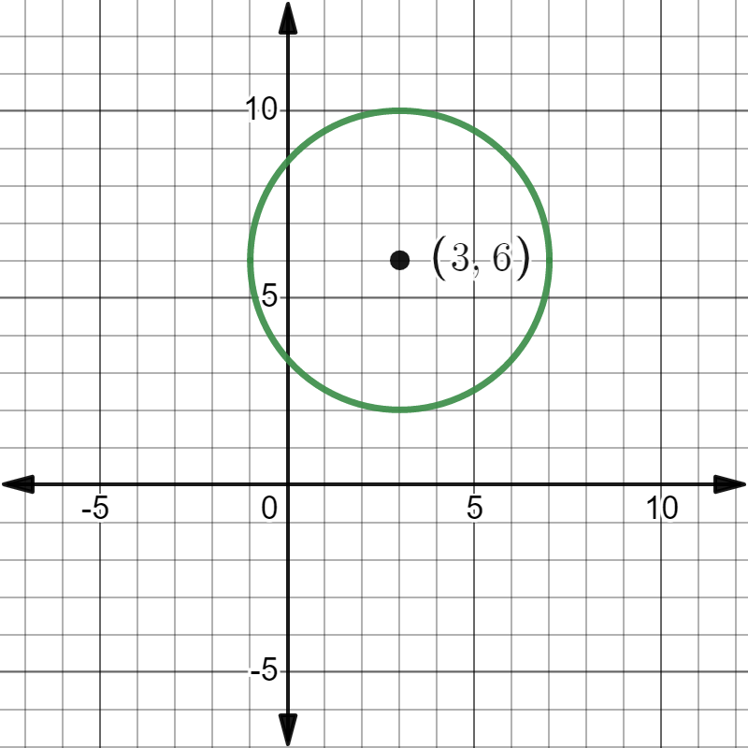
Circles
A circle is the set of all points (x, y) that are equidistant from a point called the center of the circle.
The distance between the center and any point (x,y) on the circle is the radius, “r”.
Notes:
Explain radius and center on the circle.

Slide 4
Standard Form of Circles
Notes:
Explain radius and center on the circle.

Slide 5
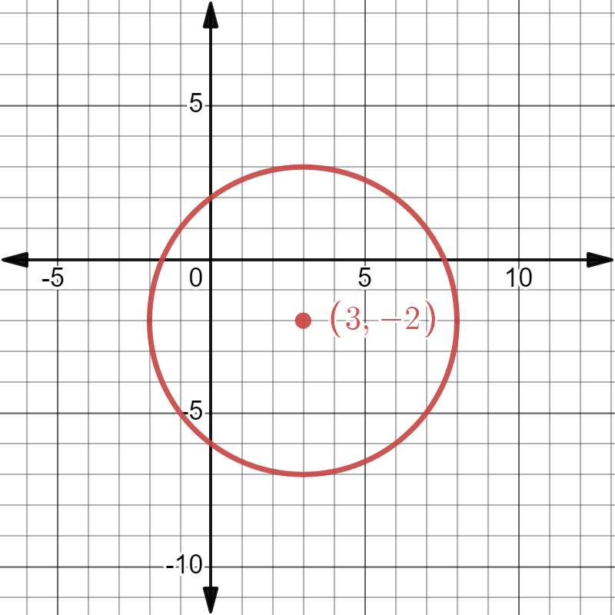

For the circle shown…
What is the equation?
${(x+3)}^{2}{+(x−2)}^{2}=\sqrt{5}$
${(x−3)}^{2}{+(x+2)}^{2}=25$
${(x+3)}^{2}{+(x−2)}^{2}=25$
Notes:
Hands up 1,2,3 to indicate choice

Slide 6
For the circle with equation ${(x−6)}^{2}+{(y−3)}^{2}=9$…
What is the radius?
81
9
$3$
$\frac{1}{9}$
Notes:
Hands up 1,2,3 to indicate choice

Slide 7
Given the center and the radius, write the equation for the circle in standard form.
Center (-3,12) and Radius = 8
Center (4,0) and Radius = 12
Center (5, 6.25) and Radius = 7.5

Slide 8
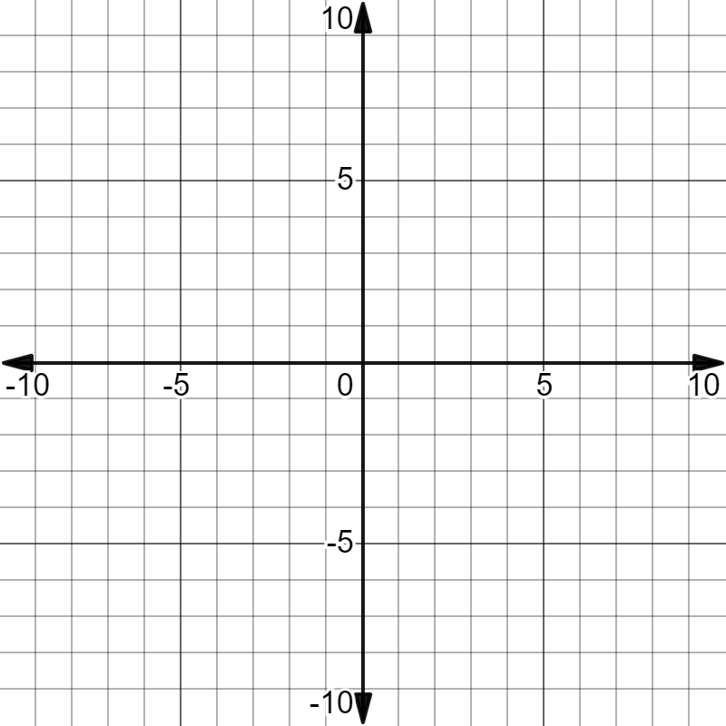
Ex 1${ (x−3)}^{2}{+(y−4) }^{2}=4$
Where is the center of the circle?
What is the radius of the circle?
Graph the circle.

Slide 9
Ex 2${ (x+5)}^{2}{+(y+2) }^{2}=8$
Where is the center of the circle?
What is the radius of the circle?
Graph the circle.

Slide 10
Ex 3${ (x−1)}^{2}{+y}^{2}=16$
Where is the center of the circle?
What is the radius of the circle?
Graph the circle.

